Slide 1
Spatio-temporal models for ecologists An overview
Jim Thorson and Noble Hendrix
Spring, 2016

Slide 2
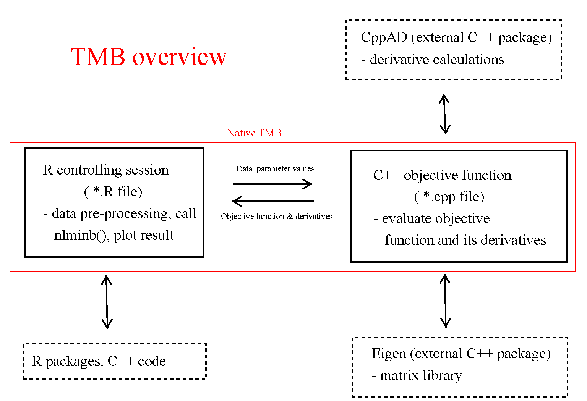
Week 1

Slide 3
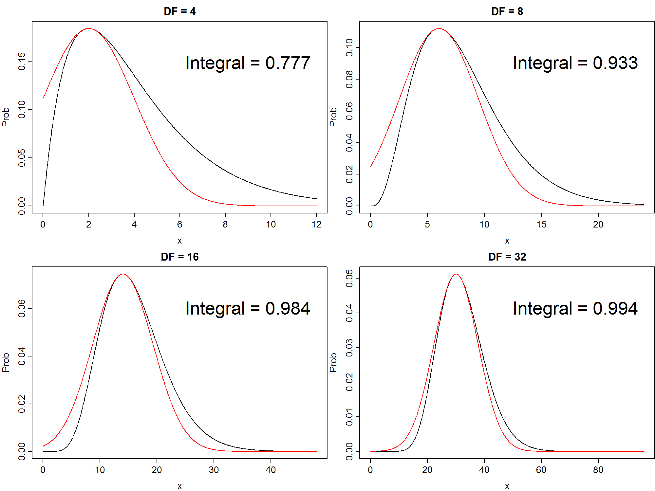
Week 2
Generalized Linear Mixed Models
Laplace approximation

Slide 4
Week 3
Temporal and state-space models

Slide 5
Week 4
Geostatistical Models

Slide 6
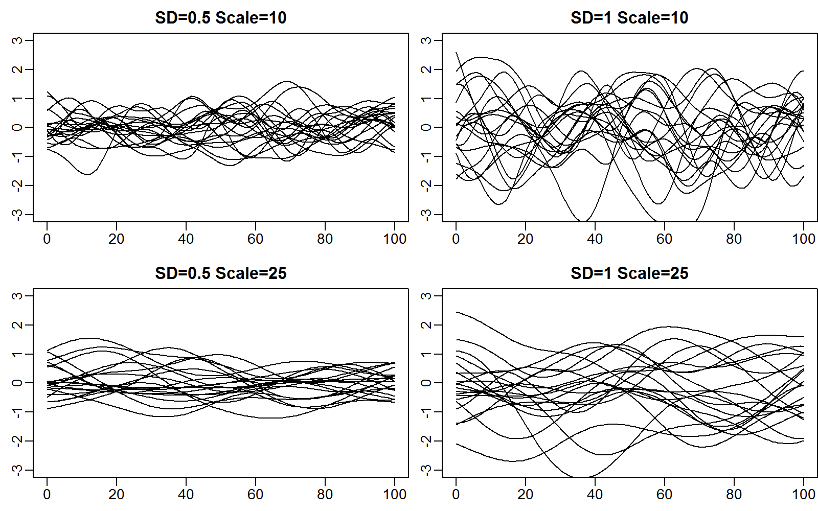
Week 5
1-D spatial models and Gaussian Process

Slide 7
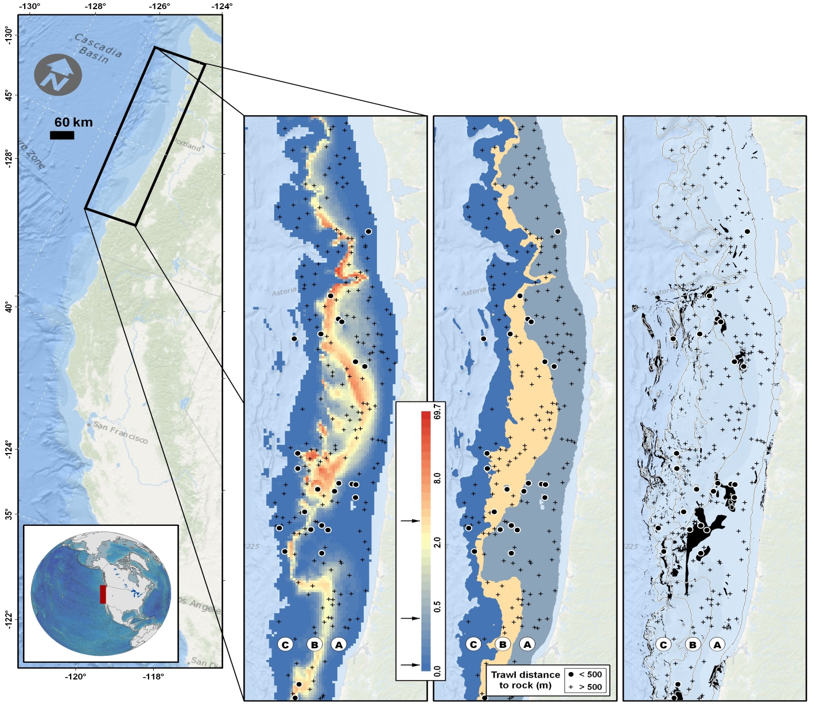
Week 6: 2D space

Slide 8
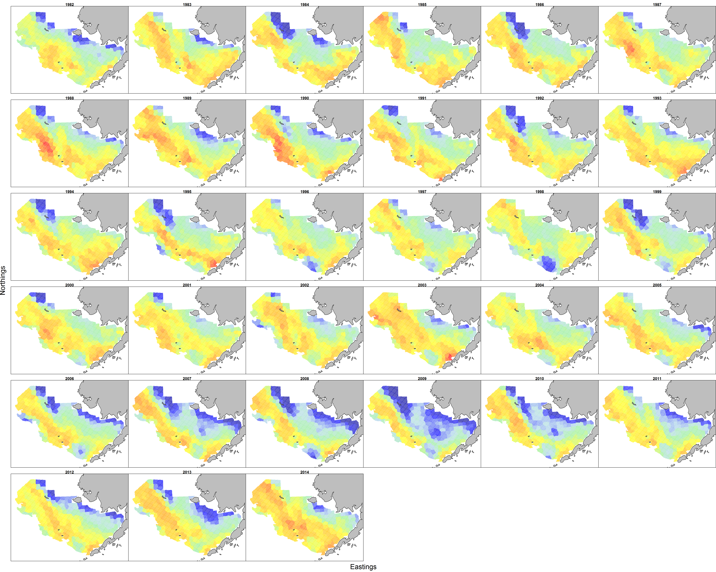
Week 7: Space and time

Slide 9
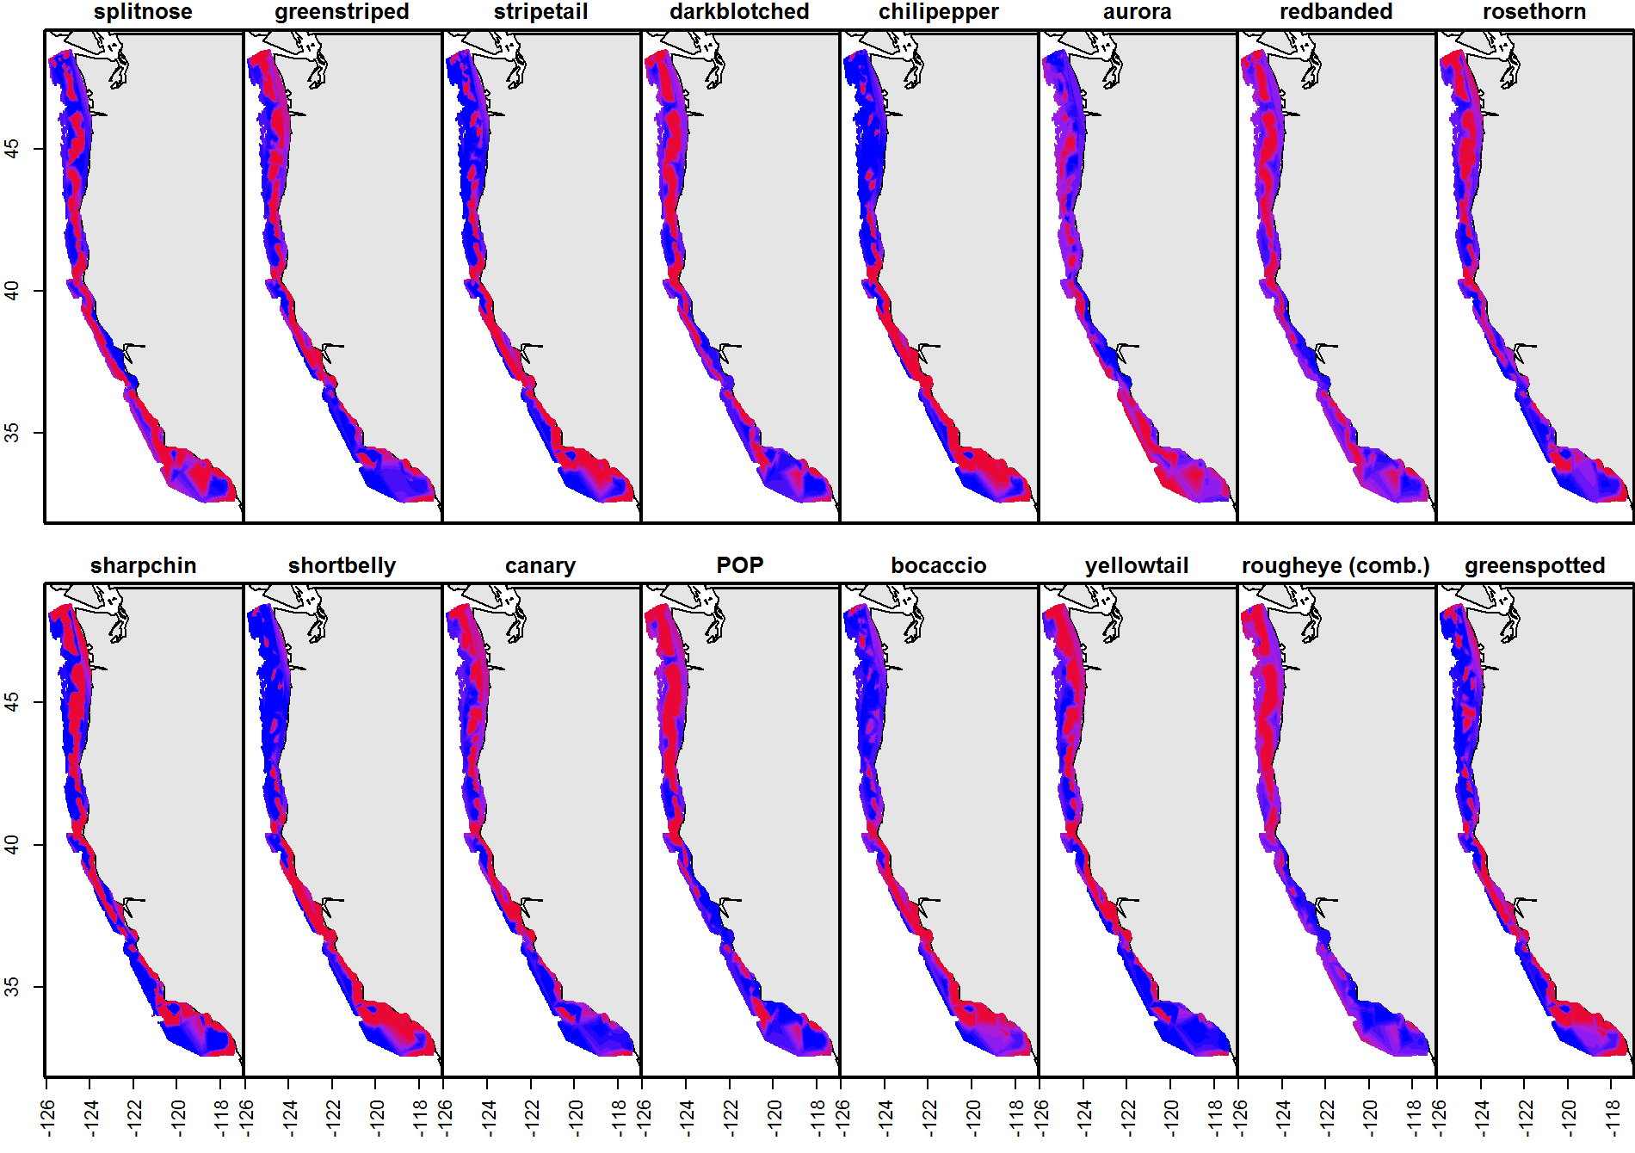
Week 8: Multivariate

Slide 10
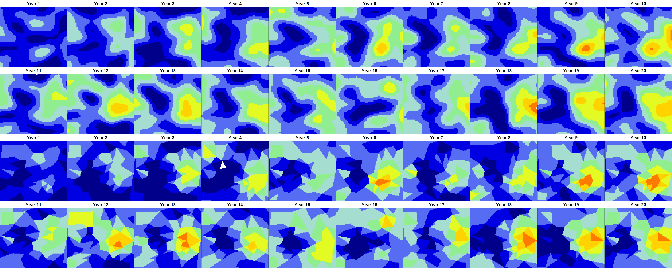
Week 9: Movement
Est / True
Est / True

